Slide 1

A0597203 AI in Business
Describing Data

Slide 2
Types of Structured Data & Levels of Measurements

Slide 3
Categorical Data vs Numerical Data
1. Qualitative or categorical (non-numerical) data:
Consists of descriptive information, such as colors, tastes, textures, or any other characteristics that can be counted.
2. Quantitative or numerical data:
Includes data that can be measured and can be represented numerically, such as height, weight, or temperature.

Slide 4
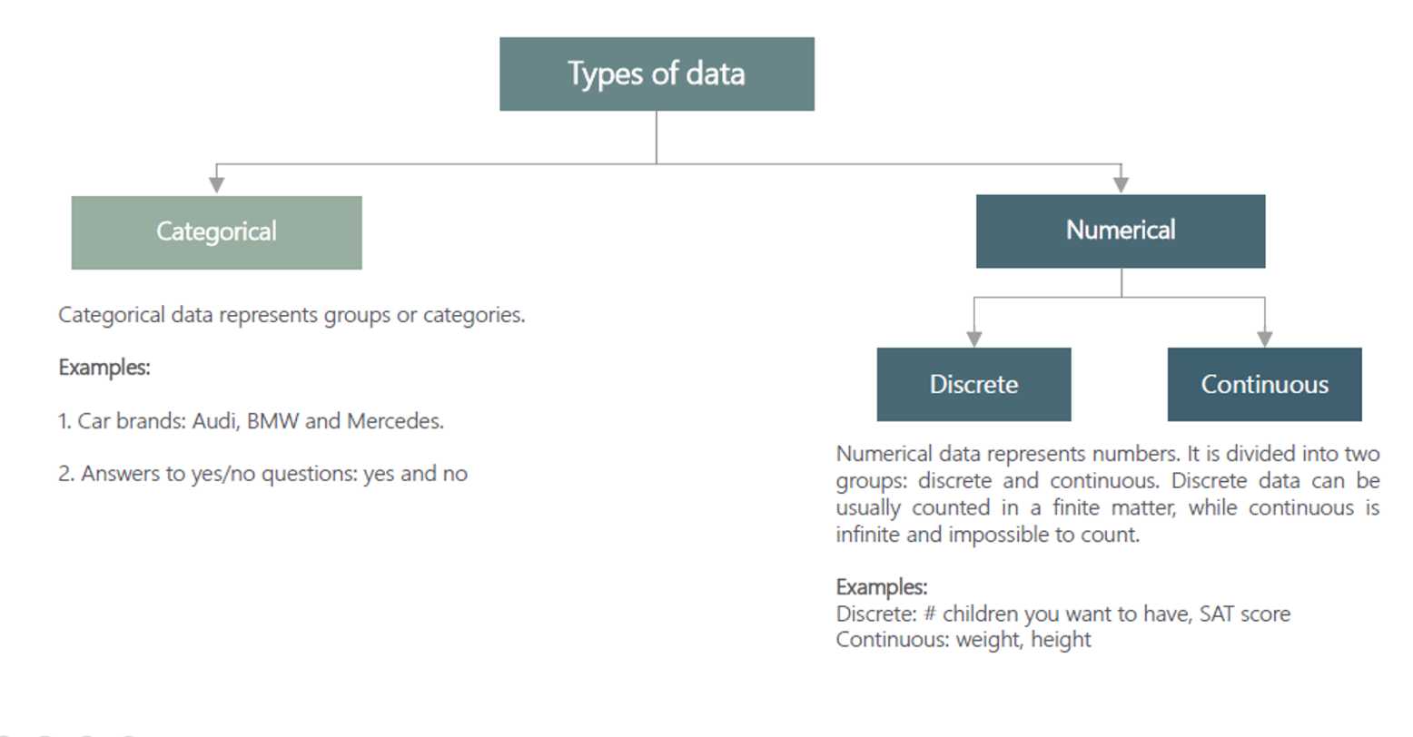

Slide 5
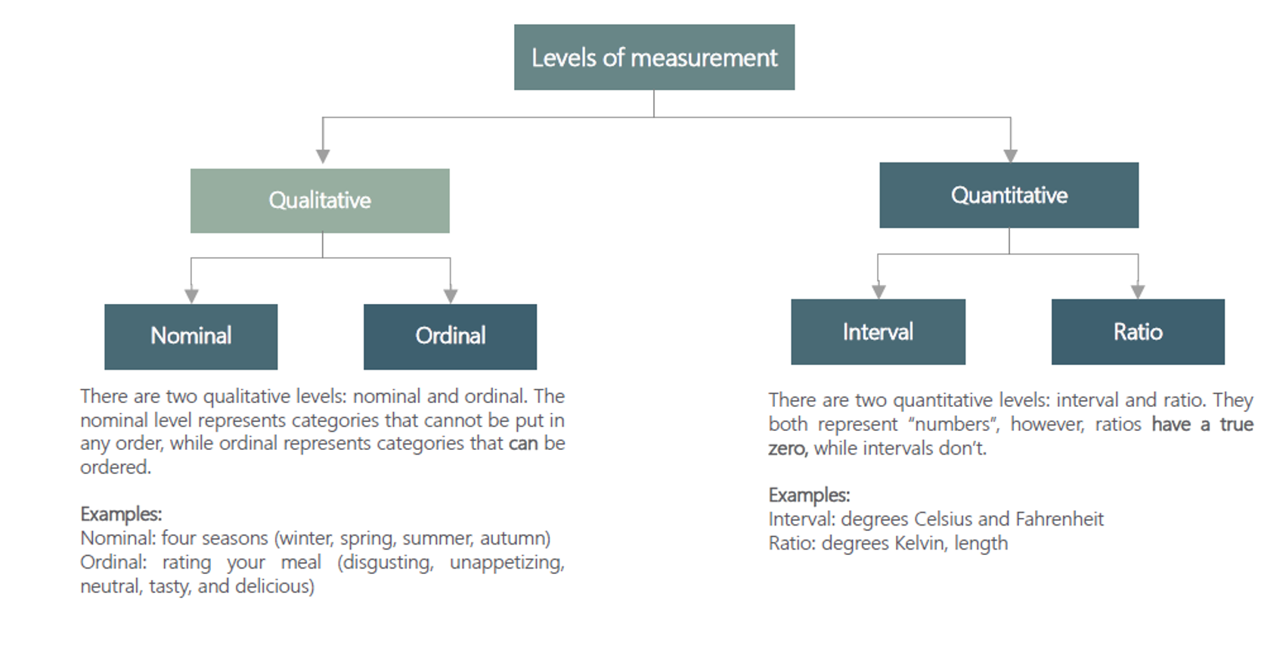

Slide 6
Why Types of Data and Levels of Measurements Matter?
Data Visualization: e.g. Categorical data might be best represented in a bar chart, while continuous data might be better suited for a histogram or scatter plot.
Data Transformation: e.g. Ordinal data might be converted into interval data under certain conditions, or continuous data might be categorized into ordinal data.
Data Quality: e.g. If you expect a variable to be discrete and find continuous values, this could indicate a data quality issue.
Interpretation of Results: e.g. If you have ordinal data, you can make statements about the order of values but not the difference between values.
Appropriate Analysis: e.g. Nominal data can be analyzed using a Chi-square test, while interval data can be analyzed using a t-test or ANOVA. Using the wrong test can lead to incorrect conclusions.

Slide 7
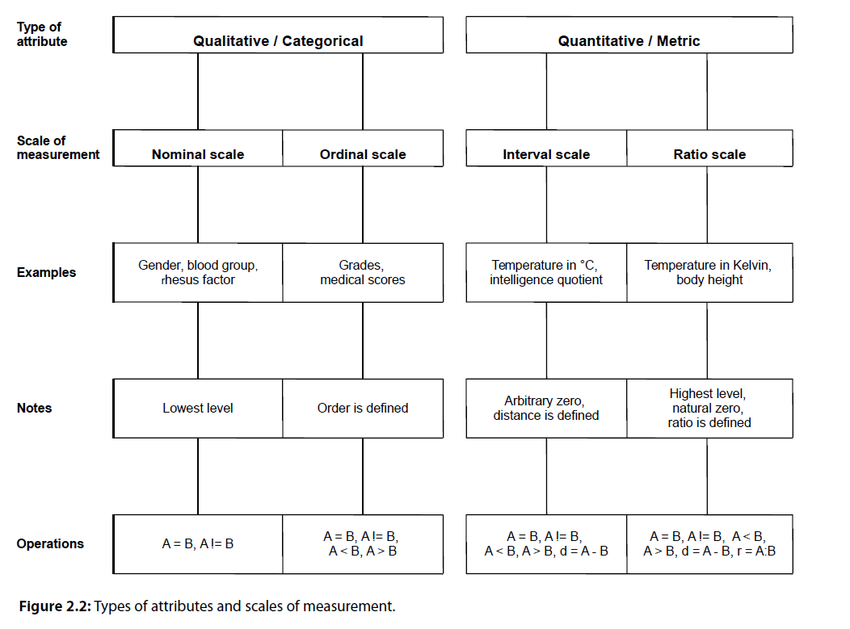
Curtesy of: Introduction to statistical analysis with R, Matheus Khol

Slide 8


Statistical Tools Used in Descriptive Statistics
Tables (Data Tables, Frequency Distribution Tables).
Visualization & Charts.
Numerical Measures (Measures of Central Location, Dispersion, Shape, Position, Association).

Slide 9
Tables in Descriptive Statistics
Tables organize and display data in a structured format.
They are essential for summarizing large data sets efficiently.
Types of Tables in Statistics
Frequency Distribution Tables: Show how often each value in a set of data occurs.
Summary Tables: Provide key statistics like mean, median, mode, range, etc., at a glance.
Contingency Tables/Cross-tabulation: Display the multivariate frequency distribution for categorical data.

Slide 10
Visualizing Qualitative Data
Bar Chart, Pie Chart, Side by Side Bars Chart

Slide 11
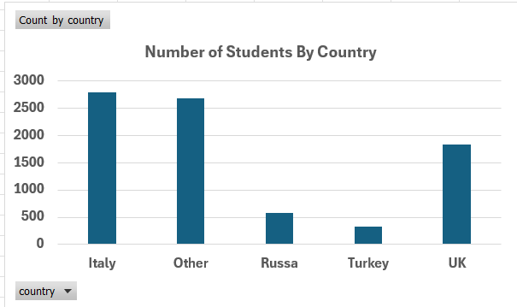
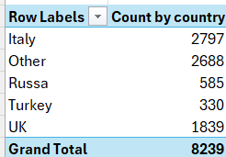
Bar Charts
A bar chart is a type of chart that presents data in rectangular bars with lengths proportional to the values they represent.
Bar charts are commonly used to compare the magnitudes of different categories or groups of data.
We need to construct a frequency table first.

Slide 12
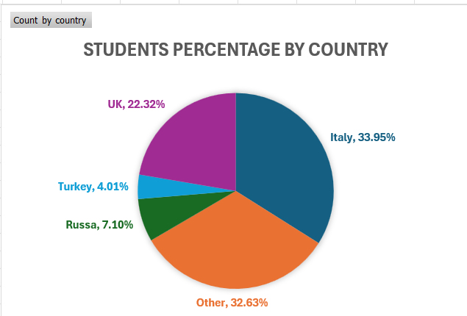
Pie Chart: Visualizing Proportions
A pie chart is a circular chart that is divided into segments to represent numerical proportions or percentages.
Each segment of the pie chart represents a different category or group, and the size of each segment is proportional to the value or percentage it represents.
Pie charts are commonly used to display data that can be divided into categories, such as market share, demographic distributions, or survey results.

Slide 13
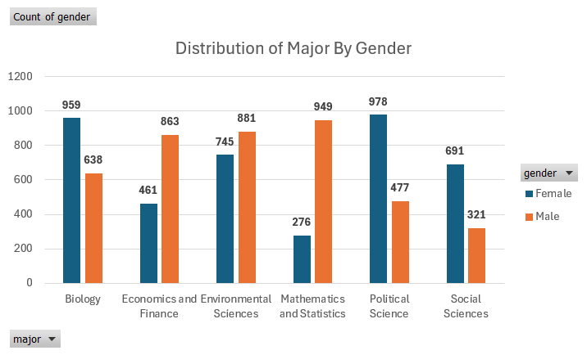
Side by Side Bar Charts: : Visualizing Two Variables
A side-by-side chart is used to compare two or more variables or categories.
The chart displays the data side-by-side in separate columns or bars, making it easy to compare the values of each variable or category.
Side-by-side chart allows viewers to quickly and easily compare the values of different variables and identify patterns or trends in the data.

Slide 14
Visualizing Quantitative Data, Frequency Distributions and Histograms

Slide 15
Histograms
Histograms provide a way to visualize the distribution of a numeric variable.
Histograms group numeric responses into bins and display the frequency of responses in each.
The x-axis of a histogram reflects the range of values of a numeric variable, while the y-axis can reflect either the frequencies (counts) or relative frequencies.

Slide 16
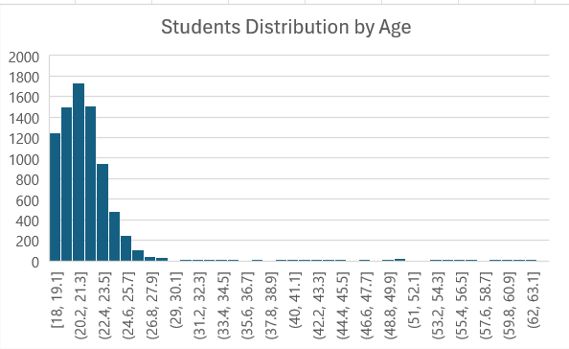
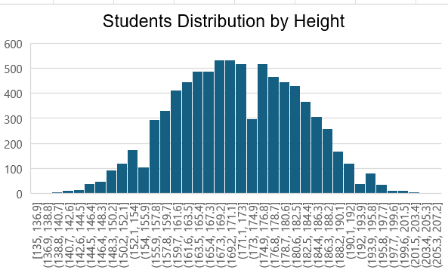
Histograms
Histograms tell us the following about our data:
Shape – what is the shape of the distribution?
Center – what is an “average” value?
Spread – how far away from the center do values tend to fall?
Unique features – are there any outliers?

Slide 17
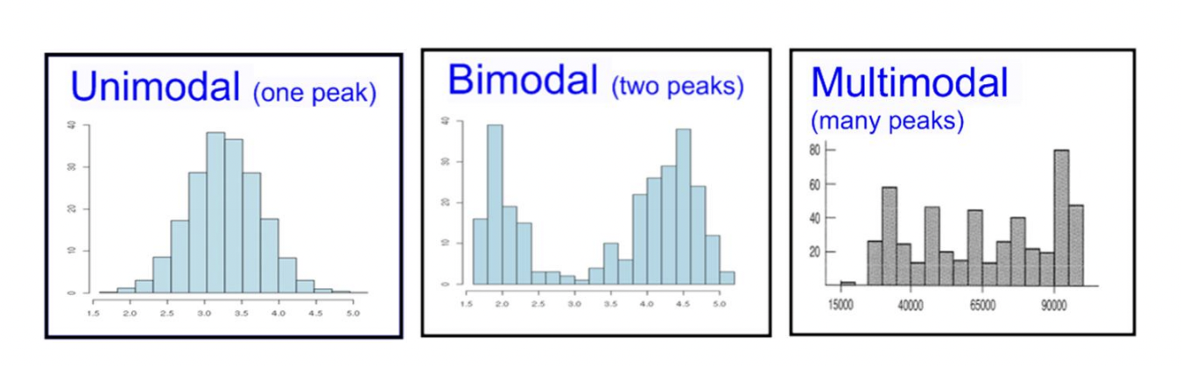
Number of Modes
The first distinguishing feature apparent in a histogram is the number of modes, or, in the distribution.
A unimodal distribution only has one peak in the distribution, a bimodal distribution has two peaks, and a multimodal distribution has three or more peaks.

Slide 18
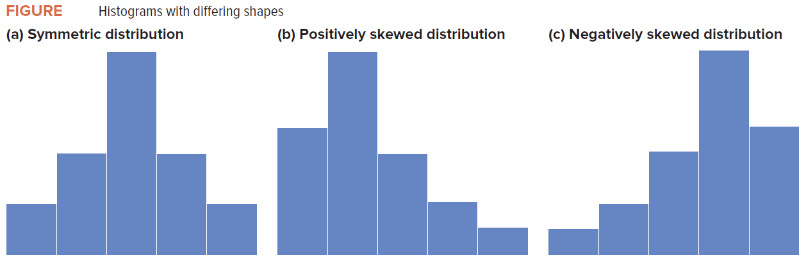
Skewness
Histograms can show us if the data is skewed or symmetric.
Symmetric data should look nearly identical if folded in half at the center point of the distribution.
Skewed data indicates that there is a large portion of the data collected on one side of the chart and only a small portion on the other side.

Slide 19
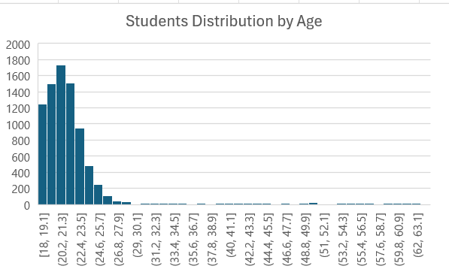
Outliers
Outliers are responses that fall well away from the rest of the values.
Histograms can be useful in identifying outliers in our data.
Defining an observation as an outlier is subjective and should lead to an investigation of that value (not an automatic removal from the dataset).

Slide 20
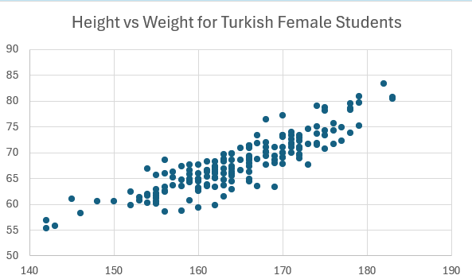
Scotter Plots
Scatter plots can be used to examine of there is a relation between two variables.
Consider for instance, how:
Incomes vary with education.
Sales vary with advertising expenditures.
Stock prices vary with corporate profits.
Crop yields vary with the use of fertilizer.
Cholesterol levels vary with dietary intake.
Price varies with reliability.

Slide 21
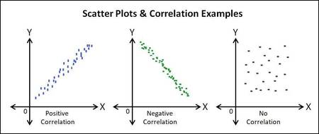
Relations between Two Variables

Slide 22
Numerical Measures in Descriptive Statistics
Measures of Central Location
Mean, Median and Mode

Slide 23
The Mean
The Arithmetic Mean is the primary measure of central location.
Generally, we refer to the arithmetic mean as simply the Mean or the Average.
In order to calculate the mean of a data set, we simply add up the observations and divide by the number of observations in the population or sample.
However, the mean is sensitive to Outliers. Consider the following sample dataset:
Data = ($1.00, $2.00, $3.00, $3.00, $3.00, $1.00, $100.00)
Most of the data values are around $3, yet their average is $16.14

Slide 24
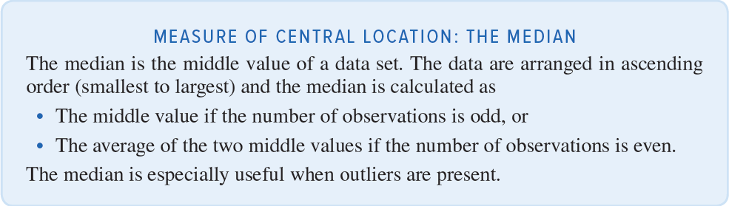
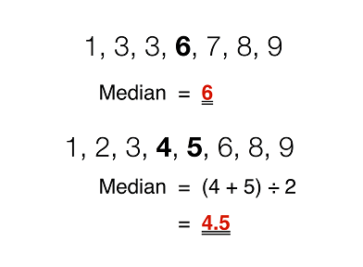
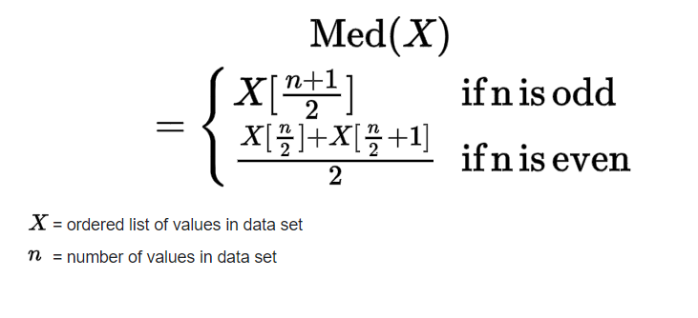
The Median

Slide 25
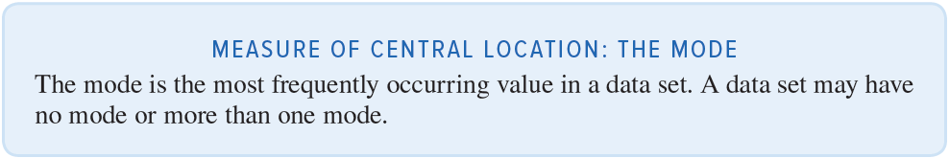
The Mode

Slide 26
Measures of Dispersion
Range, Mean Absolution Difference, Variance and Standard Deviation

Slide 27
Measures of Dispersion
Average alone is not sufficient to summarize and describe our data.
Consider the following 5 sample datasets.
Although the data values are very different, they all have the same average.
 | S1 | S2 | S3 | S4 | S5
 | 100 | 200 | 0 | -600 | -2000
 | 200 | 200 | 600 | 600 | 2500
 | 300 | 200 | 0 | 600 | 100
Average | 200.00 | 200.00 | 200.00 | 200.00 | 200.00

Slide 28
Measures of Dispersion – The Range
The Range is the simplest measure of dispersion, it is the difference between the maximum value and the minimum value in a data set:
Range = Maximum Value – Minimum Value
Going back to the previous sample datasets, we can see that they have the same average, but their ranges are very different.
 | S1 | S2 | S3 | S4 | S5
 | 100 | 200 | 0 | -600 | -2000
 | 200 | 200 | 600 | 600 | 2500
 | 300 | 200 | 0 | 600 | 100
Average | 200.00 | 200.00 | 200.00 | 200.00 | 200.00
Range | 200.00 | 0.00 | 600.00 | 1200.00 | 4500.00
Therefore, using the Range with the Average helped us to better describe and summarize our data (Better Understand Our Data).
However, the Range is sensitive to Outliers. Consider the following sample dataset:
Data = ($1.00, $2.00, $3.00, $3.00, $3.00, $1.00, $100.00)
Most of the data values are around $3, yet their Range is $99.00

Slide 29
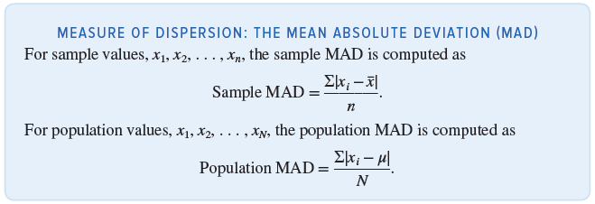
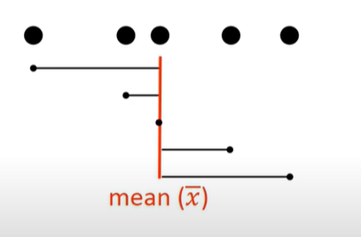
Measures of Dispersion - The Mean Absolute Deviation
A good measure of dispersion should consider differences of all observations from the mean.
If we simply average all differences from the mean, the positives and the negatives will cancel out, even though they both contribute to dispersion, and the resulting average will equal zero.
The mean absolute deviation (MAD) is an average of the absolute differences between the observations and the mean.

Slide 30
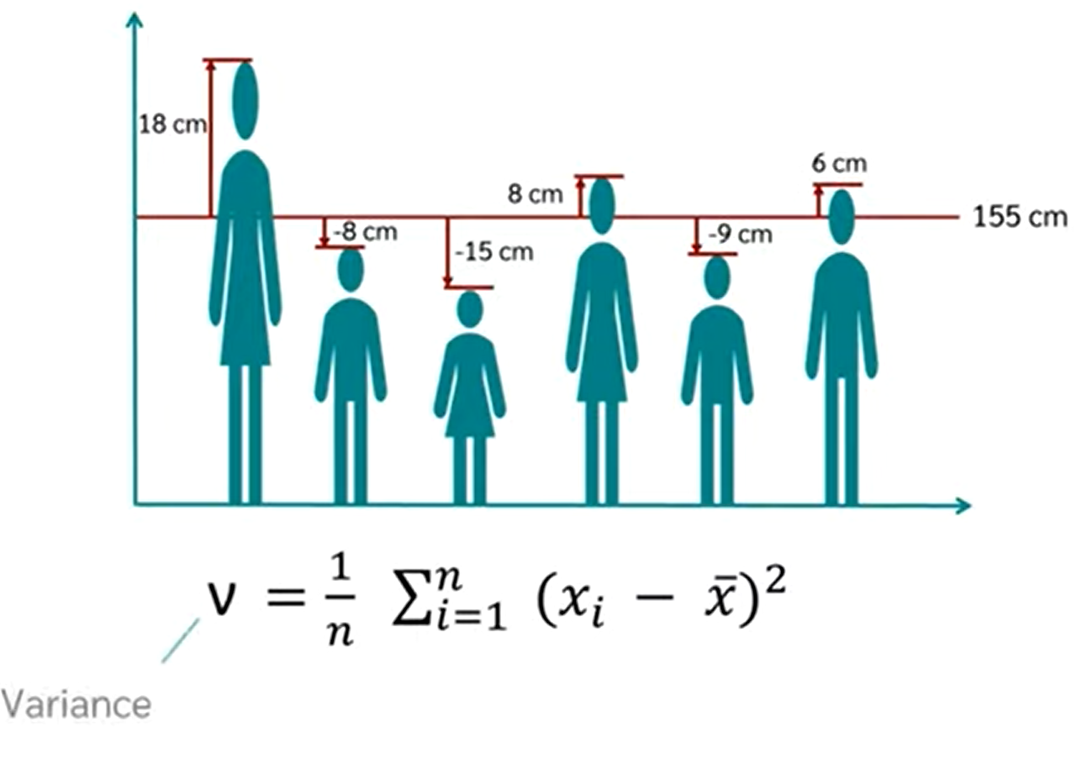
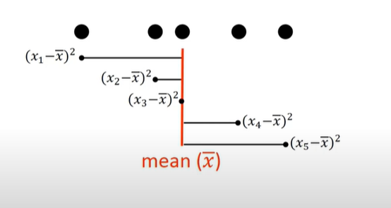
Measures of Dispersion - The Variance and the Standard Deviation
MAD weights large and small differences equally.
Better measures are the variance and the standard deviation.
Instead of calculating the average of the absolute differences from the mean, as in MAD, we calculate the average of the squared differences from the mean.
The squaring of differences from the mean emphasizes larger differences more than smaller ones.
The variance has squared units, therefore, to return the values to their original units of measurement, we compute the square root of the variance, which gives us the standard deviation.

Slide 31
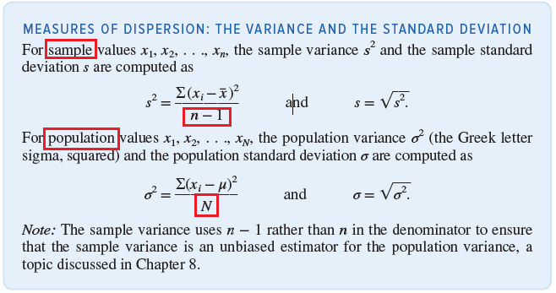
Measures of Dispersion - The Variance and the Standard Deviation

Slide 32
Measures of Association
Covariance and Coefficient of Correlation

Slide 33
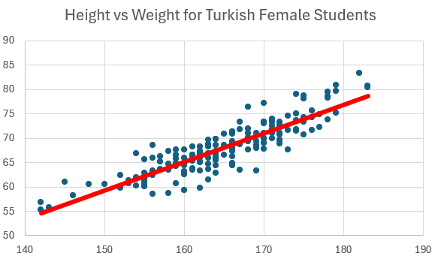
Measures of Association
We previously introduced the idea of a scatter plots to visually assess whether two variables had some type of linear relationship.
In this section, we present two numerical measures of association that quantify the direction and strength of the linear relationship between two variables, x and y.
These two numerical values are the Covariance and the Correlation.
Note: Covariance and Correlation works when the relation between the two variables is LINEAR.

Slide 34
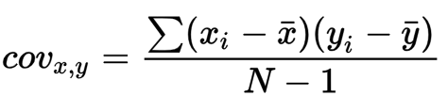
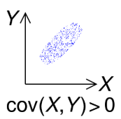
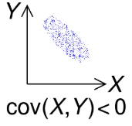
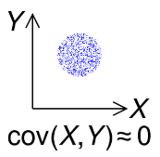
Covariance
Covariance measures the joint variability of two random variables.
Indicates the direction of the linear relationship between variables.
Positive Covariance: X and Y move in the same direction.
Negative Covariance: X and Y move in opposite directions.
Zero Covariance: No linear relationship between X and Y.

Slide 35
Limitations of Covariance
Covariance is sensitive to the units of X and Y.
Changing units changes the covariance value, making direct comparisons difficult.
 | Height m | Height cm | Weight KG
 | 1.6 | 160 | 55
 | 1.7 | 170 | 68
 | 1.8 | 180 | 74
Covariance | .95 | 95 | Which one is bigger?
Correlation | .98 | .98

Slide 36
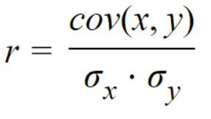
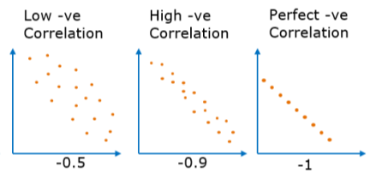
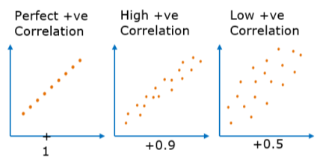
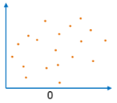
The Correlation Coefficient
Correlation coefficient can be used to determine the Direction and the Strength of a relationship between two numerical variables.
The correlation coefficient is a dimensionless metric and its value ranges from -1 to +1.
The closer it is to +1 or -1, the more closely the two variables are related.
Correlation Formula

Slide 37
Differences between Covariance and Correlation
Covariance | Correlation
Covariance indicates the direction of the linear relationship between variables. | Correlation measures both the strength and the direction of the linear relationship between two variables.
Covariance value can vary between -∞ and +∞ | Correlation value ranges between -1 and +1
Covariance unit is based on the product of the units of the two variables. | Correlation is dimensionless, i.e. It’s a unit-free measure of the relationship between variables.

